Slide 1

Team 8 Trends in Programming Languages

Slide 2


Data
Stackoverflow
Tags
Comments
Posts
User
Votes
Stackexchange
Software Engineering
Data Science
Software recommendations

Slide 3
Expected Results

Slide 4
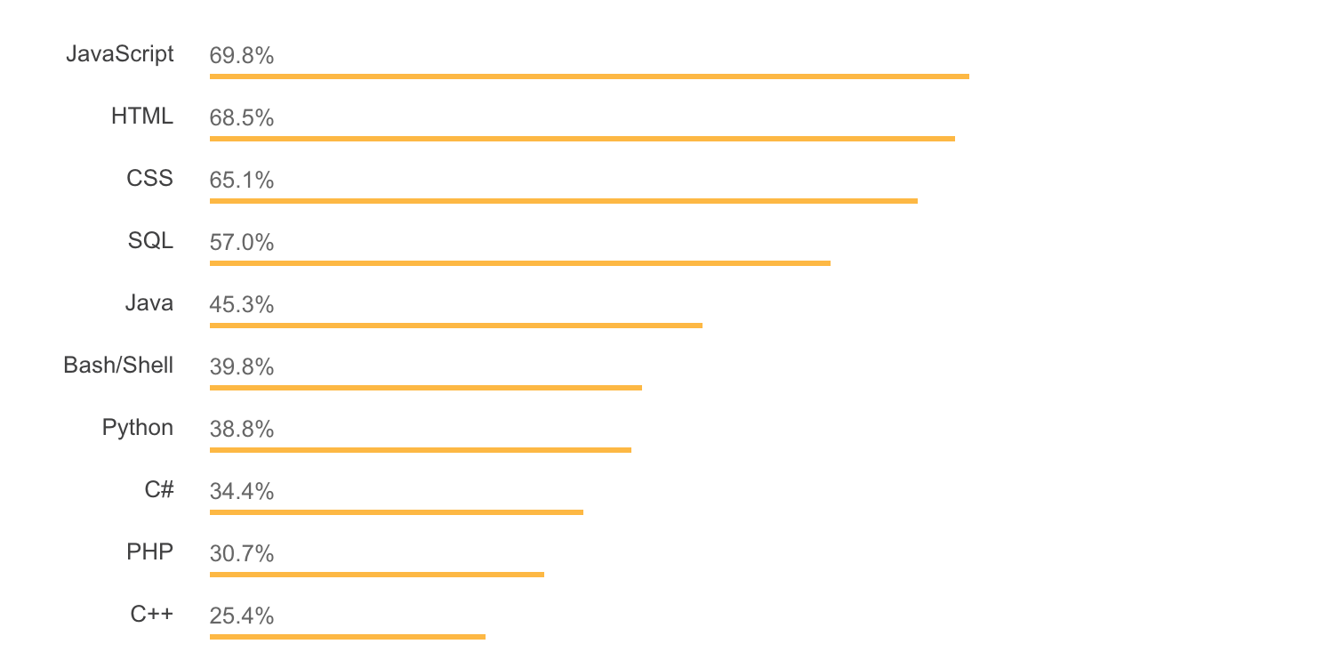
Trends in programming languages

Slide 5
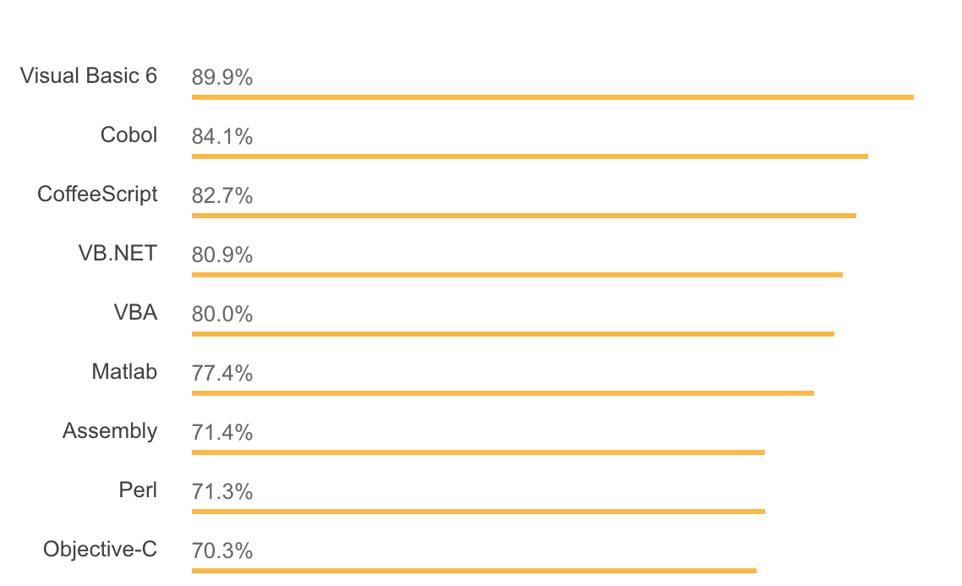

Most loved/dreaded languages
These languages are actually dreaded !!

Slide 6
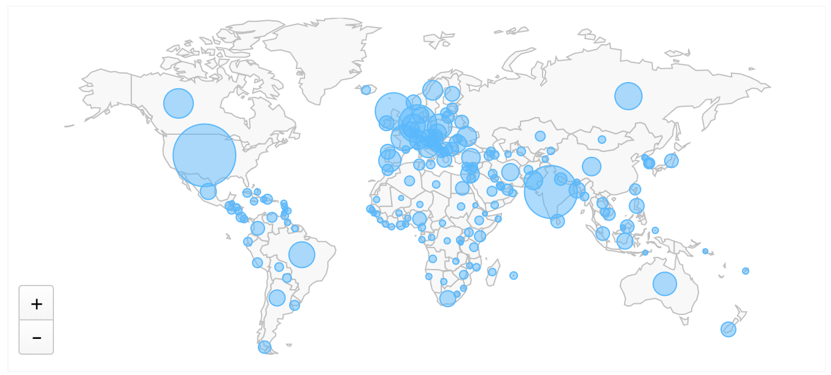
Programmers in different countries

Slide 7
Challenges faced

Slide 8
Challenges faced
Enormous size of data!! ~ 60 GB
What we did?
Data is only huge if it’s not properly cleaned/formatted.
Removed unnecessary columns
Changed format from XML to CSV
Size reduced to 2-5 GB
SQL operations on 5 GB of data is not easy!!
What we did?
Ingested data into Hive tables
Performed complex operations directly in Hive

